Slide 1

PREDICTING FOOD INSECURITY SEVERITY IN KENYA USING SATCLIP FOUNDATION MODEL EMBEDDINGS AND IPC PHASE DATA
Mary Muthee
Copernicus Master in Digital Earth, 2025

Slide 2








What are Foundation Models
Very large AI models trained on huge amounts of data
They learn general patterns instead of one specific task
After training, they can be used for many tasks (classification, mapping, predictions)
Reduce the need for labelled data in remote sensing

Slide 3
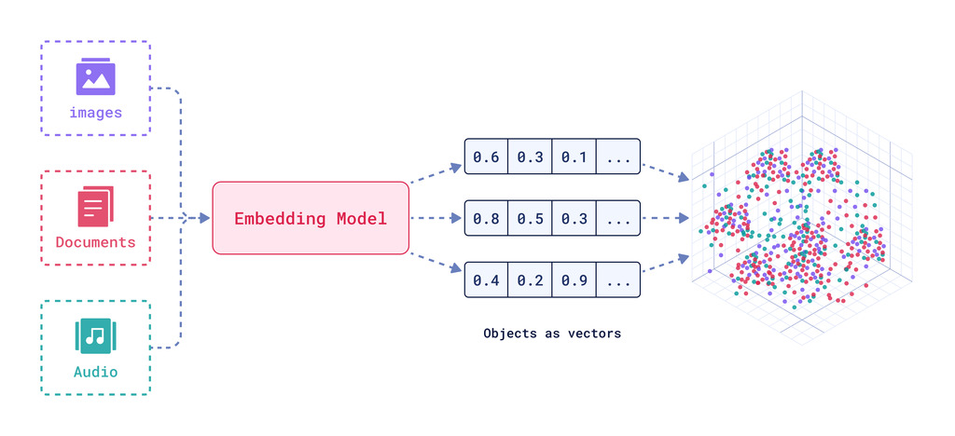
What are Embeddings
Vectors (numbers) that the model creates to describe something
These numbers capture the overall meaning. (forest- green, trees, humid etc)
They let us measure similarity

Slide 4
Remote Sensing Foundation Models
Large AI models trained on massive geospatial datasets to learn general, transferable representations
Vision foundation models
Vision language foundation models
Generative foundation models
Vision location foundation models
Vision audio foundation models
Task specific etc
https://github.com/Jack-bo1220/Awesome-Remote-Sensing-Foundation-Models _learn more on RSFMs here

Slide 5
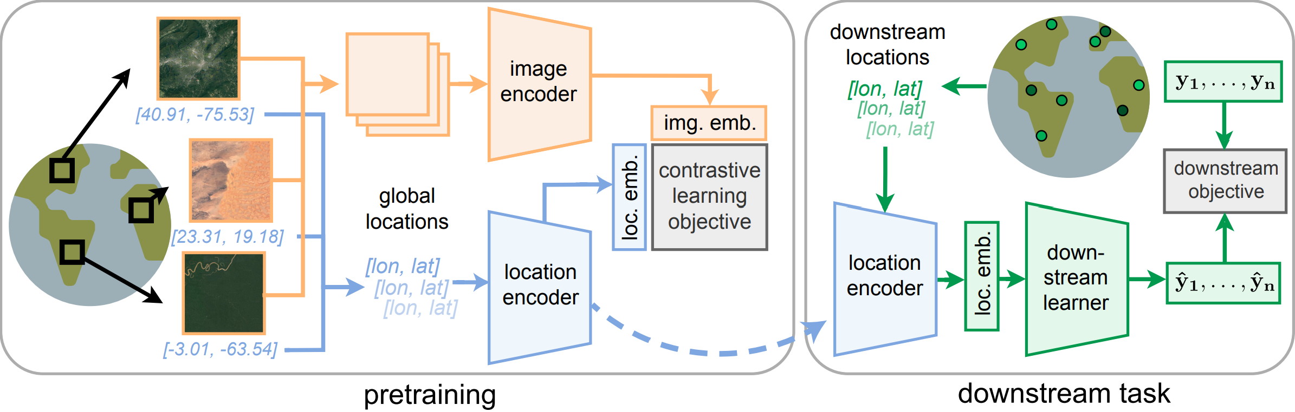
SatCLIP Foundation Model
Designed specifically for satellite imagery and location data.
It learns global environmental patterns (vegetation, climate, land cover, dryness, elevation) from massive Sentinel-2 and climate datasets.
It produces image embeddings and location embeddings

Slide 6
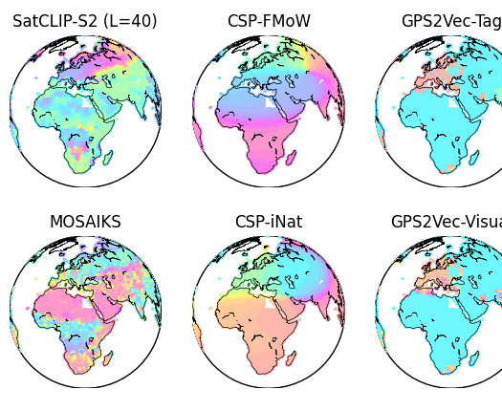
SatCLIP Foundation Model- neural networks
ResNet-18
ResNte-50
ViT-16 (Vision Transformer)
For mor eon how SatCLIp is build:
1. Github repo- https://github.com/microsoft/satclip
2. Published paper- https://arxiv.org/abs/2311.17179

Slide 7
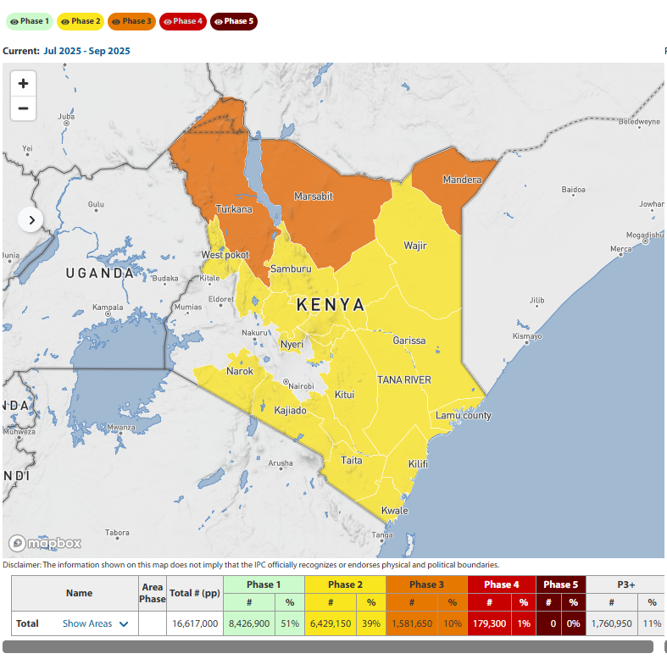
Study Background :IPC
The Integrated Food Security Phase Classification (IPC) is a global system used to measure and compare food insecurity levels in a standardized way.
A common scale from Phase 1 (Minimal) to Phase 5 (Famine).
Use IPC data from Kenya
Image source: IPC Kenya

Slide 8
Objectives
To use SatCLIP embeddings to represent environmental conditions across Kenyan counties.
To examine whether these embeddings can help classify areas in Crisis (IPC ≥ 3) using logistic regression and map crisis probability across the country
Create a continuous severity measure by weighting all IPC phases (1–5) and mapping overall severity across Kenya using satclip embeddings and regression models
Estimate and map the proportion of the population living in Crisis, Emergency, or Famine (Phases 3–5) using embeddings and random forest model

Slide 9
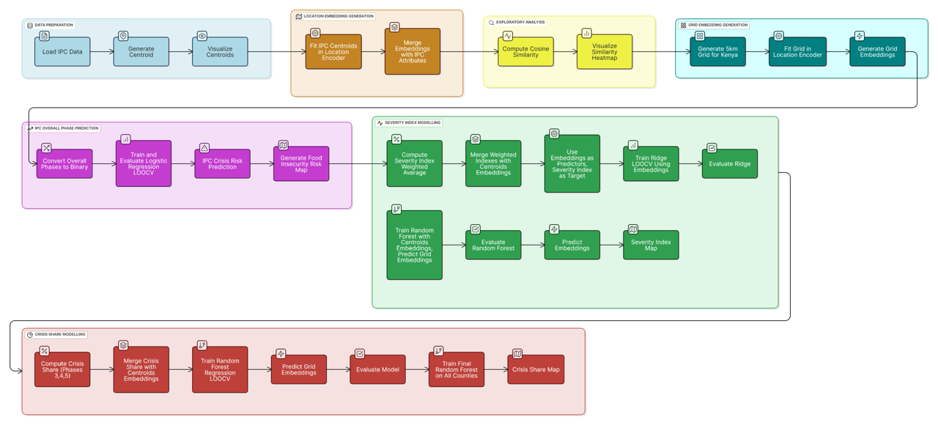
Methodology

Slide 10
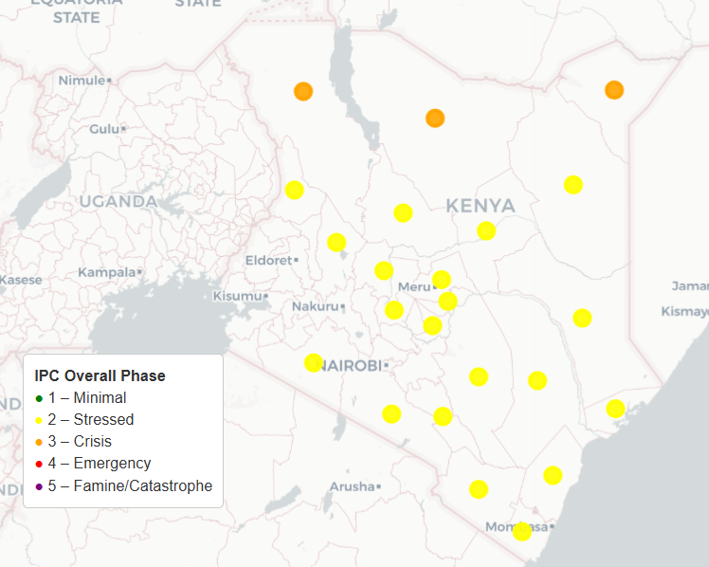
Results: Centroids
Centroids
IPC KENya map

Slide 11
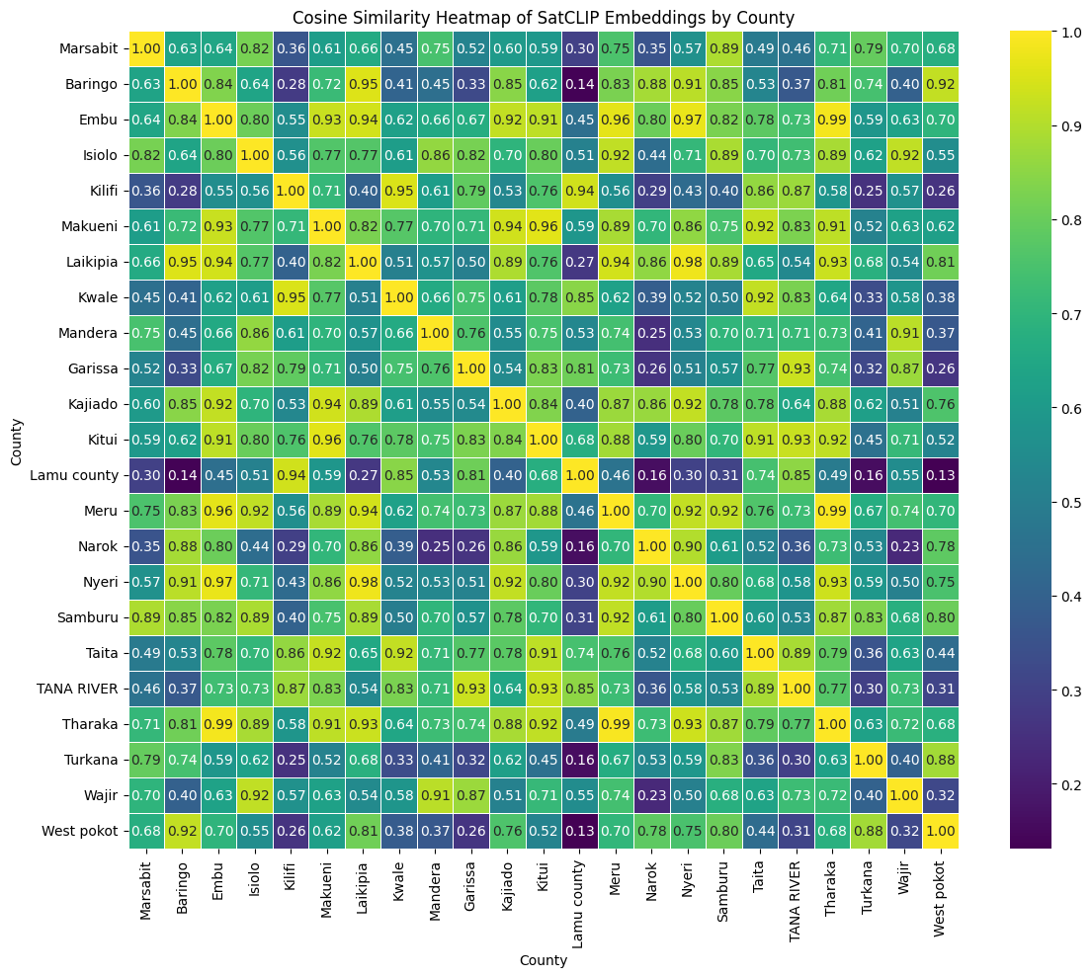
Results: Cosine Similarity HeatMap

Slide 12
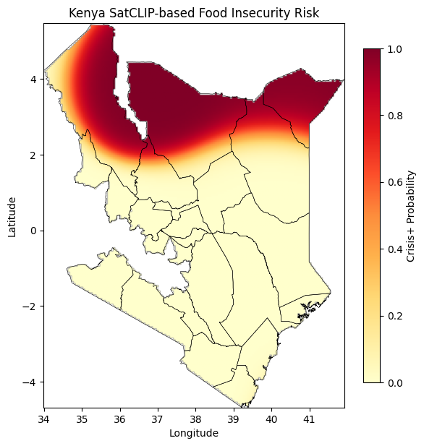
Results
Crisis Probability map
IPC KENya map
Phase 1- Minimal
Phase 2- Stressed
Phase 3-Crisis
Phase 4- Emergency
Phase 5- Famine

Slide 13
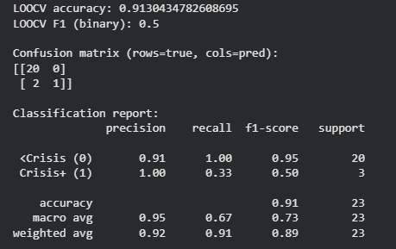
Models Performance Metrics: Logistic Regression
Used 23 labelled datasets for binary classification (Crisis vs not Crisis)
The model achieved 91% LOOCV accuracy, meaning it predicted most areas correctly.
The non-crisis class was learnt very well (20/20 correct).
The model struggled with the Crisis+ class (Phase ≥ 3) due to only 3 samples, resulting in a lower F1 score.

Slide 14
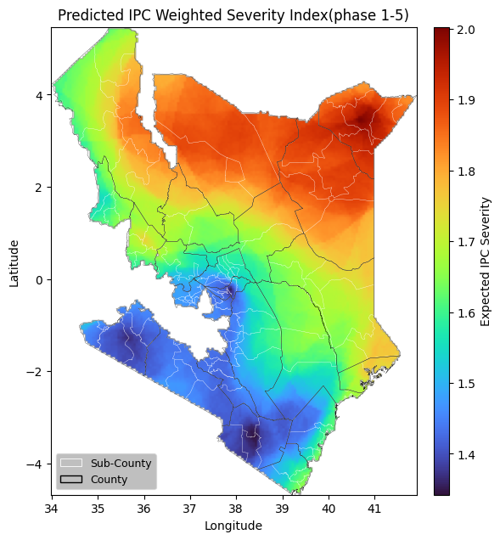
Results
IPC Severity classes
IPC KENya map
Phase 1- Minimal
Phase 2- Stressed
Phase 3-Crisis
Phase 4- Emergency
Phase 5- Famine

Slide 15
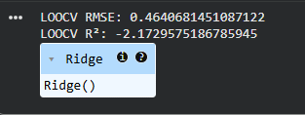
Models Performance Metrics: Ridge Regression
Ridge Regression gave a high RMSE (~0.46) and a negative R², showing poor performance.
This means the model did not fit the severity index well.
Because of this, I moved to a Random Forest model, which handles complex relationships better.

Slide 16
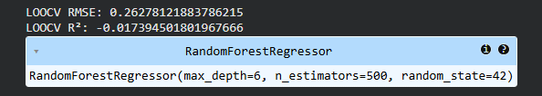
Models Performance Metrics: Random Forest
Random Forest performed better than Ridge Regression, with a lower RMSE (~0.26).
the R² was close to zero, meaning the model still struggled to explain the severity index.
Results improved, but not enough for strong predictive performance.
Model performance could maybe be improved by incorporating socio-economic and demographics data with eembeddinsg

Slide 17
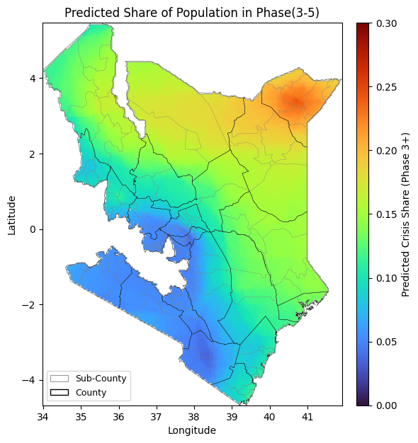
Results
Population share (phase 3+)
IPC KENya map
Phase 1- Minimal
Phase 2- Stressed
Phase 3-Crisis
Phase 4- Emergency
Phase 5- Famine

Slide 18
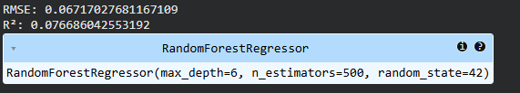
Models Performance Metrics: Random Forest
model achieved a very low RMSE (~0.067), meaning the predictions were quite close to the true crisis-share values.
R² was slightly positive (~0.08), showing the model captured some real pattern, but still not very strong.
Random Forest performed better on crisis share than on the severity index.
This suggests crisis share is easier to model from SatCLIP embeddings compared to full severity.

Slide 19

Limitations
SatCLIP provides environment-only features which are not enough to explain complex IPC outcomes. Need to integrate with demographic, socio-economic data among others
Very small labelled dataset (23 areas) which limits model learning

Slide 20

Conclusion/Recommendations
SatCLIP embeddings can capture broad environmental patterns relevant to food insecurity.
Environmental features alone are not enough to explain multi-dimensional IPC outcomes.
Recommendations
Use SatCLIP image encoder
Integrate non-environmental variables

